Slide 1


Evan Meikleham
05 December 2021

Slide 2

Outline
Executive Summary
Introduction
Methodology
Results
Conclusion
Appendix

Slide 3
Executive Summary
Summary of methodologies
Summary of all results

Slide 4
Introduction
We want to enter the Commercial Space Sector, but there is a large barrier to entry
If we can guess whether a rocket is reusable, we can better predict our costs
We will be training a predictive model that takes in the data about a launch and predicts whether the Falcon 9 first stage rocket will or will not be able to land.

Slide 5


Slide 6
Methodology
Executive Summary
Data collection methodology:
SpaceX has a publicly available API (api.spacexdata.com) where physical and engineering data about each launch can be retrieved. Additional data was retrieved by web-scraping from Wikipedia tables.
Perform data wrangling
Python (NumPy and Pandas) were used to format data to be fed into statistical models. Missing data was removed or cleaned, and launches were classified as “success” or “failure”
Perform exploratory data analysis (EDA) using visualization and SQL
Perform interactive visual analytics using Folium and Plotly Dash
Perform predictive analysis using classification models
SkiKit-Learn was used to train various classes of statistical classification models, and the best ones was selected.

Slide 7
Data Collection
Physical data was collected by using SpaceX’s public API https://api.spacexdata.com/v4/
Rockets/Boosters
Launch Sites
Payload Data
Core Data
Python packages (Mostly NumPy and PANDAS) were used to drop irrelevant fields and place the data into usable tables
Missing values were either dropped or else replaced with mean values (among Falcon 9 launches)

Slide 8
Data Collection – SpaceX API
Data collection via SpaceX REST calls can be seen at https://github.com/evanakm/coursera-project/blob/master/Week%201-1.ipynb
Get Booster Data from SpaceX API
Get Launch Location Data from API
Get Payload Data (mass and orbit) from API
Get Core Data (legs, landing pad, fins, number of times reused, etc.
Organize into a dictionary
Filter for Falcon 9 launches. Replace missing values for payload mass with average mass.

Slide 9
Data Collection - Scraping
Webscraping via BeautifulSoup can be seen at https://github.com/evanakm/coursera-project/blob/master/Week%201-2.ipynb
Get Falcon 9 Data from Wikipage (use requests Python library)
Use BeautifulSoup to extract tables from pages
Get table of first launches
Extract Flight number, site, payload, mass, orbit, customer, outcome, booster, landing, date and time
Organize into a dictionary
Export as a PANDAS DataFrame

Slide 10
Data Wrangling
Making the decision about how to classify launches as successful or not
Notebook available at https://github.com/evanakm/coursera-project/blob/master/Week%201-3.ipynb
Figure out the number of launches and success rate per launch site
Figure out the outcome and success rate per orbit type
Separate successes (grouped by landing in ocean, ground pad, drone ship) from unsuccessful landings/mission failures.
Encode success as 1 in the ‘Class’ variable

Slide 11
EDA with Data Visualization
Plots to analyze
Payload Mass vs Flight Number (color coded by success/failure) (to see if heavier/lighter rockets had more success as SpaceX became more experienced)
Launch Site vs Flight Number (see if some sites are more prone to success/failure over time)
Payload vs Site (see if heavier loads are launched from some locations)
Success Rates of mission/orbit types (and also see successes over time)
Success Rate by year (see the rate of technological improvement)
https://github.com/evanakm/coursera-project/blob/master/Week%202-2.ipynb

Slide 12
EDA with SQL
SQL Queries
Distinct Launch sites
Cumulative and average payloads by site/booster version
Date of first successful launch
Boosters that have had successes
Number and rate of success/failures
https://github.com/evanakm/coursera-project/blob/master/Week%202-1.ipynb

Slide 13
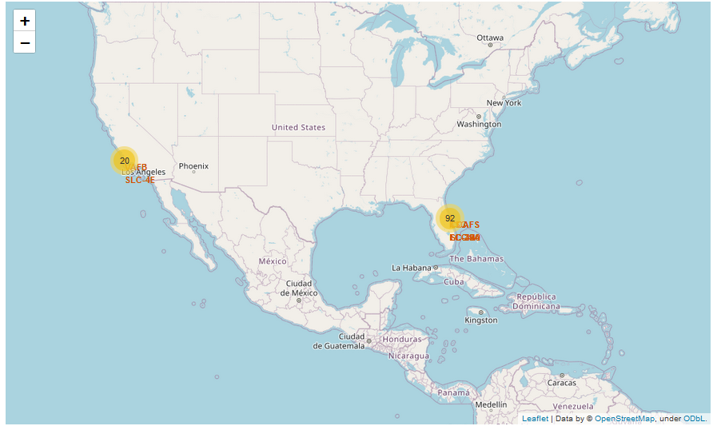
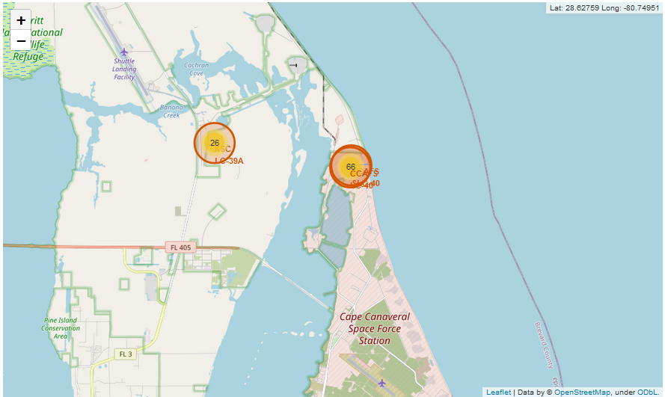
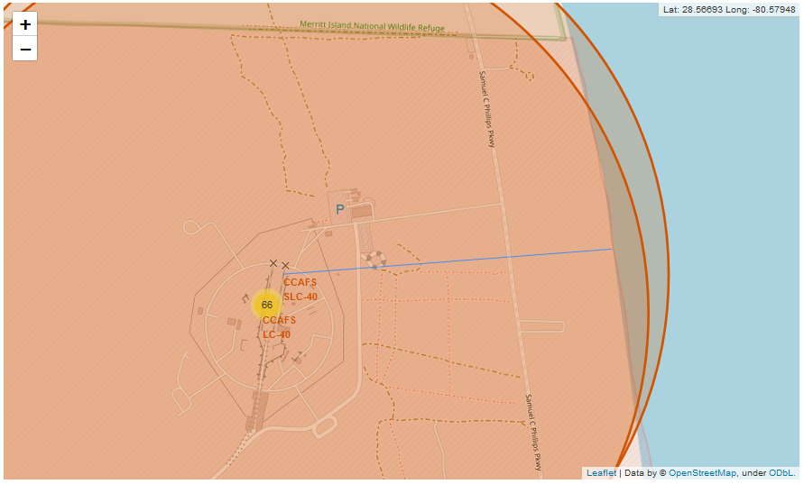
Build an Interactive Map with Folium
We used the Folium package to create masks with launch sites, with clusters of launch sites so that the maps were not too busy or confusing
We wanted to see how close the launch sites are to the coast
https://github.com/evanakm/coursera-project/blob/master/Week%202-3.ipynb

Slide 14
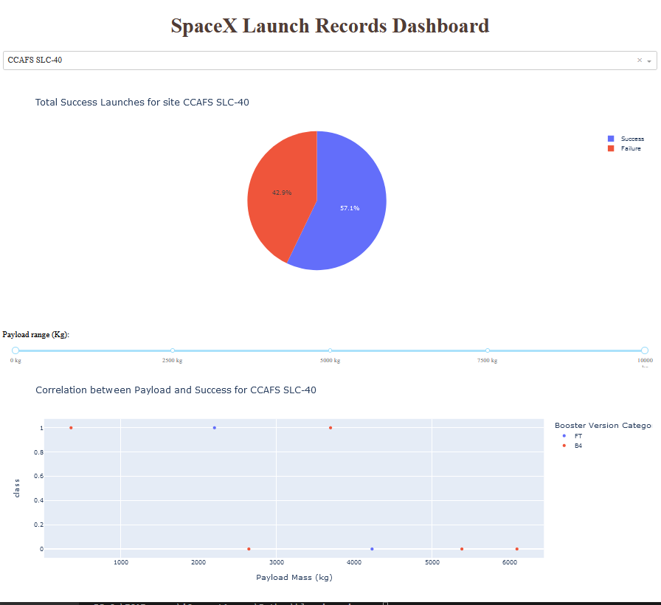
Build a Dashboard with Plotly Dash
We can plot success rates by launch site and be able to change a pie chart interactively
Also plotted successes vs payload mass (and booster category) filtered interactively by Launch Site
https://github.com/evanakm/coursera-project/blob/master/spacex_dash_app.py

Slide 15
Predictive Analysis (Classification)
Turn all values into numerical and one-hot categorical variables
There are two categories to predict, so simple separation models can be trained. (Logistic regression, support vector, nearest neighbor, and decision tree) https://github.com/evanakm/coursera-project/blob/master/Week%204-1.ipynb
Turn data into numerical values and store in PANDAS frames
Standardize the independent variables into z-scores
Divide into training and test sets
Use GridSearchCV to try to fit logistic regression, support vector, nearest neighbor, and decision tree using 10-fold cross validation to training set
Get scores of best models on the test set, and look at confusion matrix
Decide on the method and model that has the best score for the test set

Slide 16
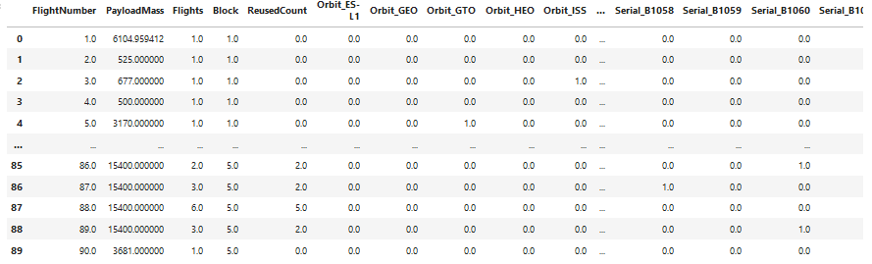
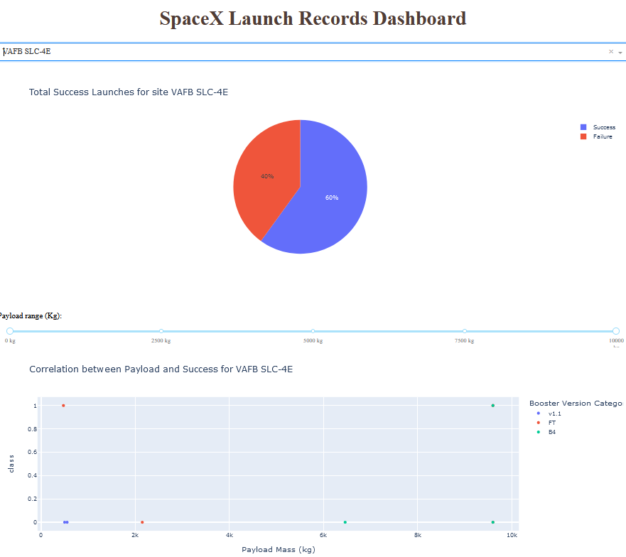
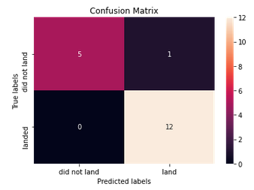
Results
Exploratory data analysis results: an predictive dataframe was created (topmost image)
Interactive analytics demo in lower left (different site than the previous slide)
Predictive analysis. Confusion matrix was the same for all methods. (Lower right)

Slide 17


Slide 18
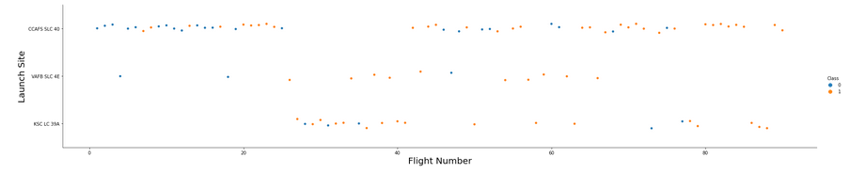
Flight Number vs. Launch Site
As time goes on, more missions were launched from CCAFS SLC40, and the success rate clearly goes from mostly failing to mostly succeeding
As time goes on, fewer launches are made from VAFB SLC 4E

Slide 19
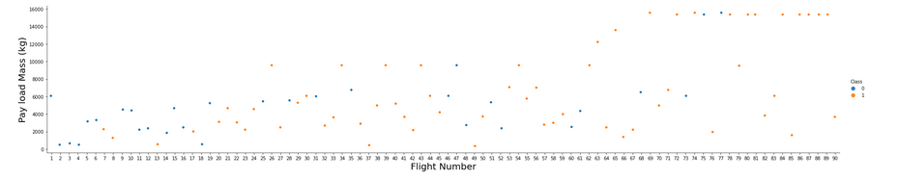
Payload vs. Launch Site
As time goes on, more missions were launched with higher payloads, up to a max of 16000 kg, and the success rate (of rocket reusability) is getting closer to 100%
It is harder to visually see patterns below the maximum payload, but the success rate is clearly higher as time goes on

Slide 20
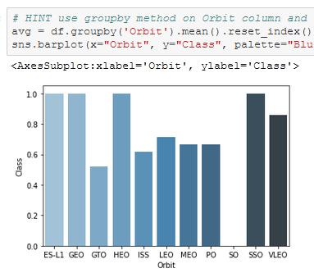
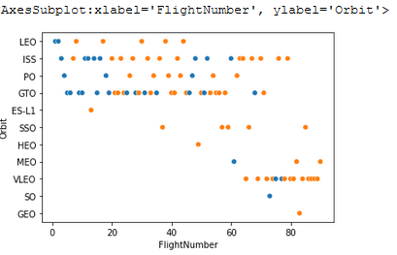
Success Rate vs. Orbit Type
There are 100% success rates for certain orbits (ES-L1, GEO, HEO, and SSO)
GTO and ISS missions have a lower success rate
We can see from the Orbit vs Flight Number plot that there were many more GTO/ISS missions, whereas some of the orbits with high success rates only had one or two missions.

Slide 21
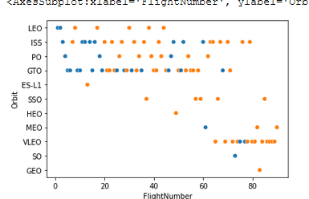
Flight Number vs. Orbit Type
As time goes on, there are more Very Low missions.
Most of the missions are to the ISS (International Space Station) or GTO missions.

Slide 22
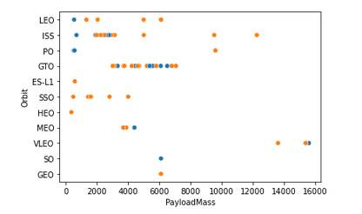
Payload vs. Orbit Type
The highest payloads were for the Very Low (VLEO) missions
Most GTO missions had payloads between ~3000 and ~8000 kilograms

Slide 23
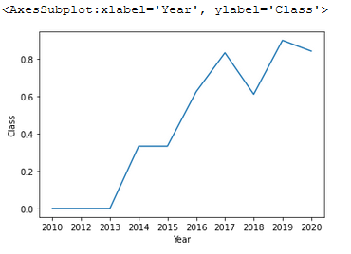
Launch Success Yearly Trend
The first success was in 2014
Since 2019, the success rate has been above 80%
There have been more successes than failures since 2016.

Slide 24
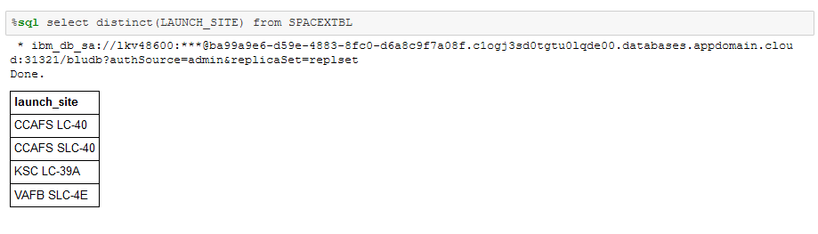
All Launch Site Names
The SQL query for the unique launch sites
There are four unique launch sites

Slide 25
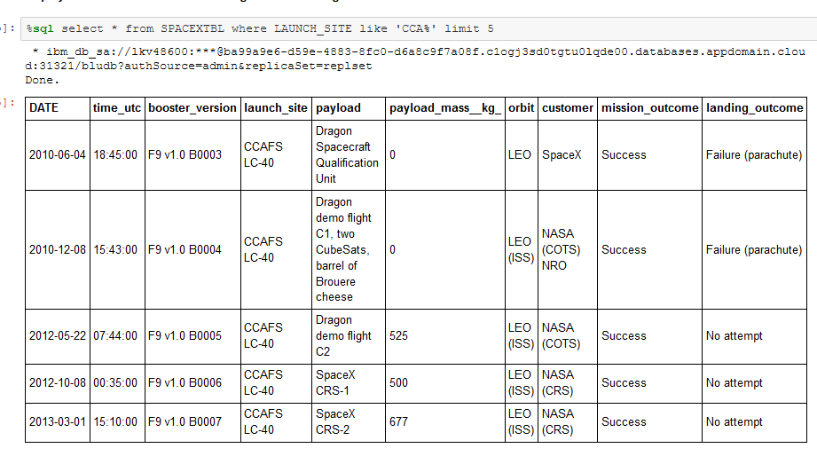
Launch Site Names Begin with 'CCA'
5 records of launches from sites starting with CCA
Missions here are launched by both SpaceX and NASA. There are no successful landings, but the years are early.

Slide 26
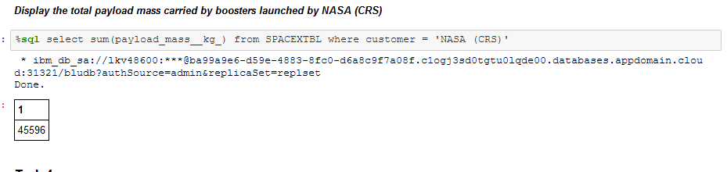
Total Payload Mass
NASA (CRS) rockets carried a cumulative total of 45,596 kilograms

Slide 27
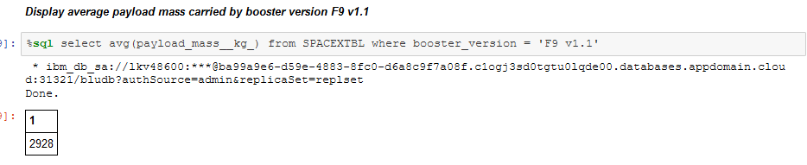
Average Payload Mass by F9 v1.1
The average payload of a F9 v1.1 mission is 2928 kg

Slide 28
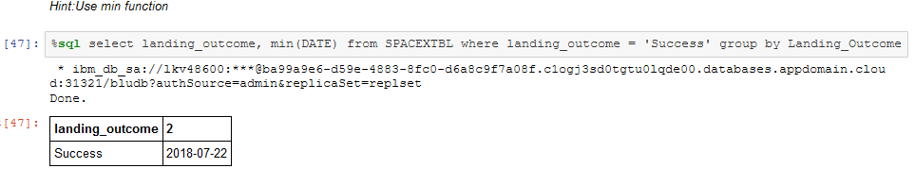
First Successful Ground Landing Date
First successful ground landing date was 2018-07-22

Slide 29
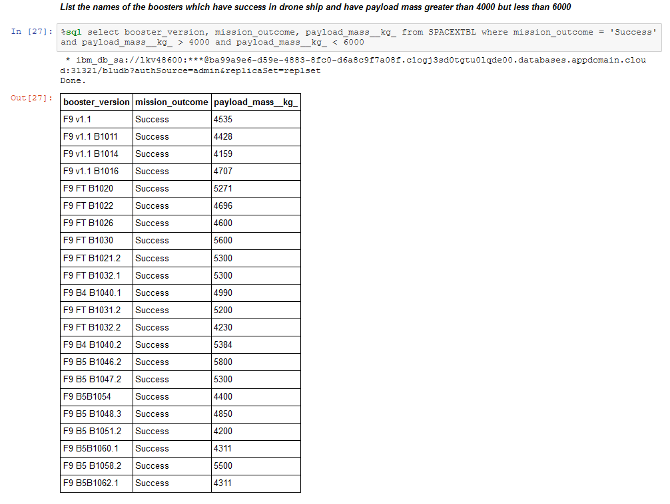
Successful Drone Ship Landing with Payload between 4000 and 6000
Boosters which have successfully landed on drone ship and had payload mass greater than 4000 but less than 6000: (Prefix only, full names in screenshot)
F9 v1.1
F9 FT
F9 B4
F9 B5

Slide 30
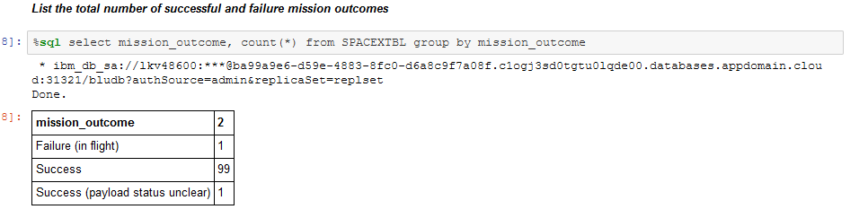
Total Number of Successful and Failure Mission Outcomes
100 successful missions,
1 failure

Slide 31
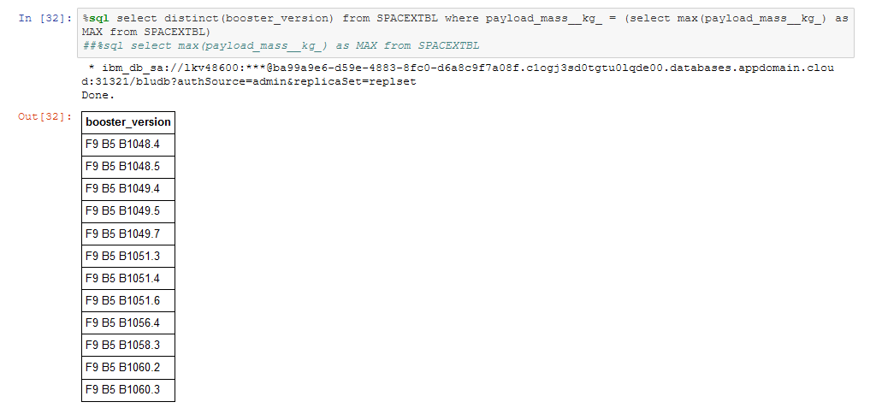
Boosters Carried Maximum Payload
All boosters that carried the maximum payload were F9 B5

Slide 32
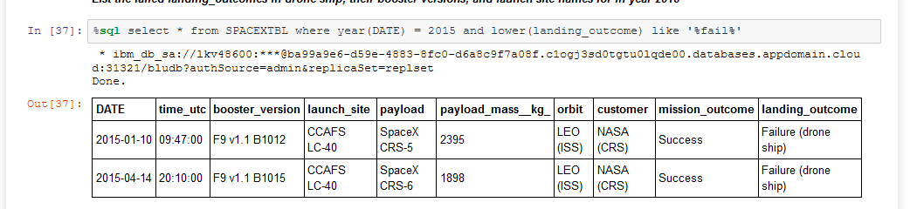
2015 Launch Records
There were two failed landing outcomes in 2015 (“No attempt” and “Precluded” were not included in failures)
Both were launched from CCAFS LC-40, and both were LEO ISS missions launched by NASA.

Slide 33
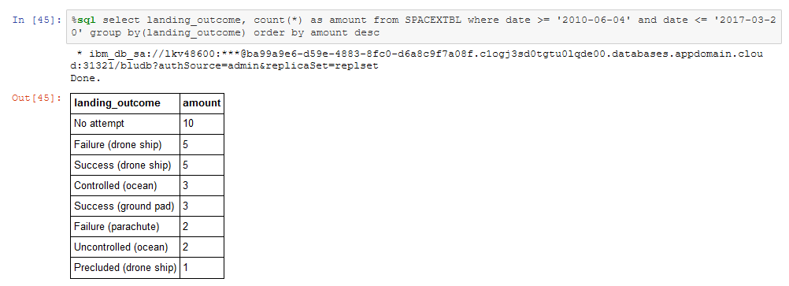
Rank Landing Outcomes Between 2010-06-04 and 2017-03-20
Most landings were not attempted, followed by failures on a drone ship and success on a drone ship, in equal quantities.

Slide 34


Slide 35
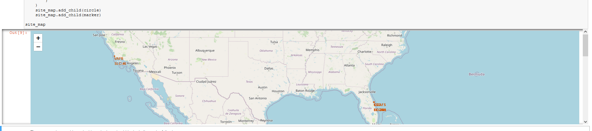
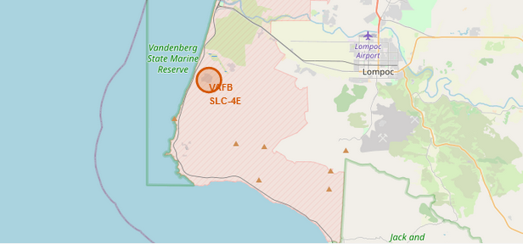
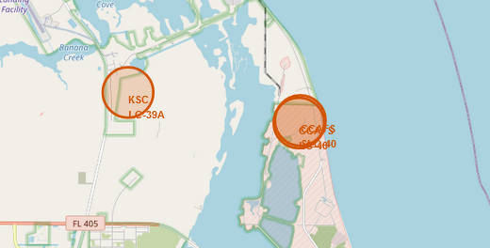
Launch Sites
The Launch sites are in California and Florida, near the coasts

Slide 36
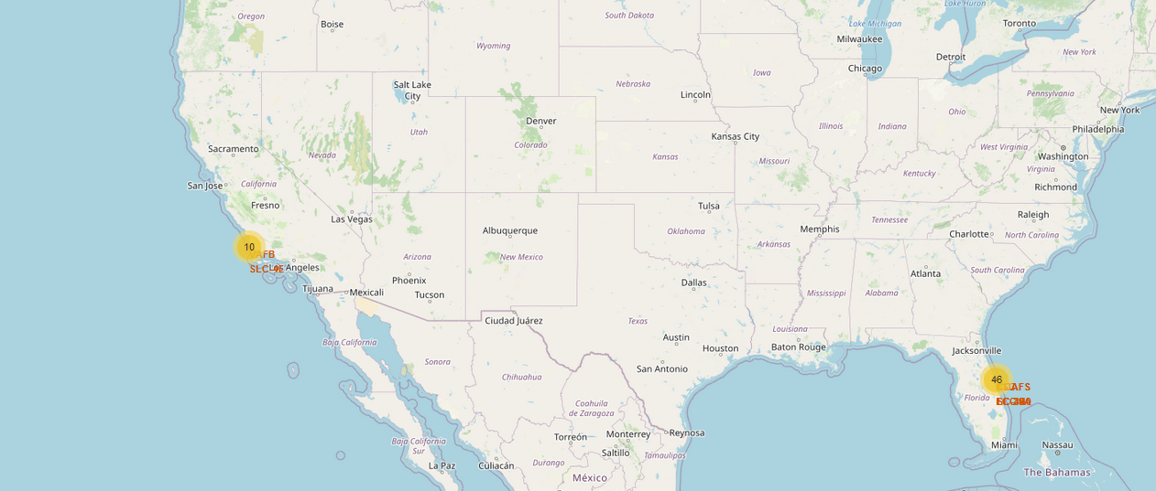
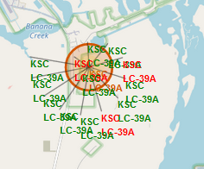
Launches by Launch Site
Launches are clustered by site, especially when zoomed out.
Launches with successful landings are indicated by green, otherwise red. (Colored labels only seen when clicked, as in the lower right)

Slide 37
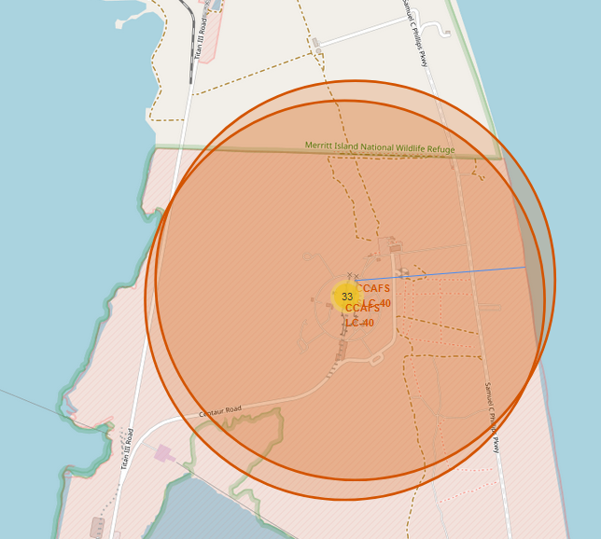
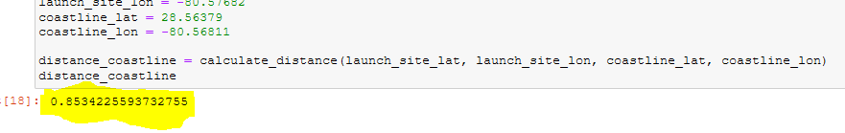
Distance from the coast
The CCAFS location is 0.8534 km from the coast

Slide 38


Slide 39
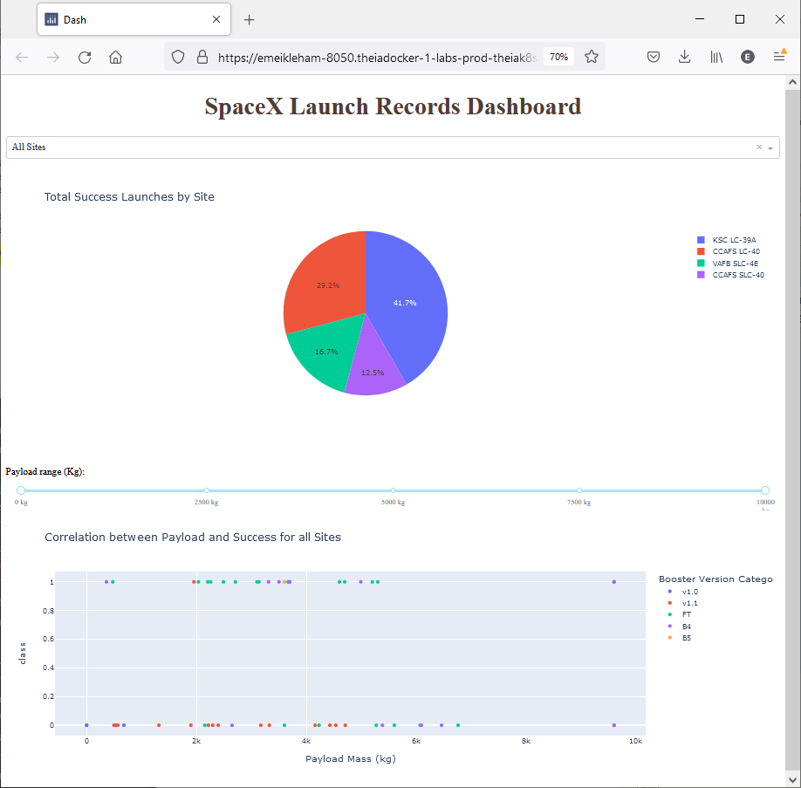
Launch Successes by Type
41.7% (the most) successes came from Kissimmee St Cloud (KSC LC-39A)
Note that “All Sites” is chosen in the dropdown menu.

Slide 40
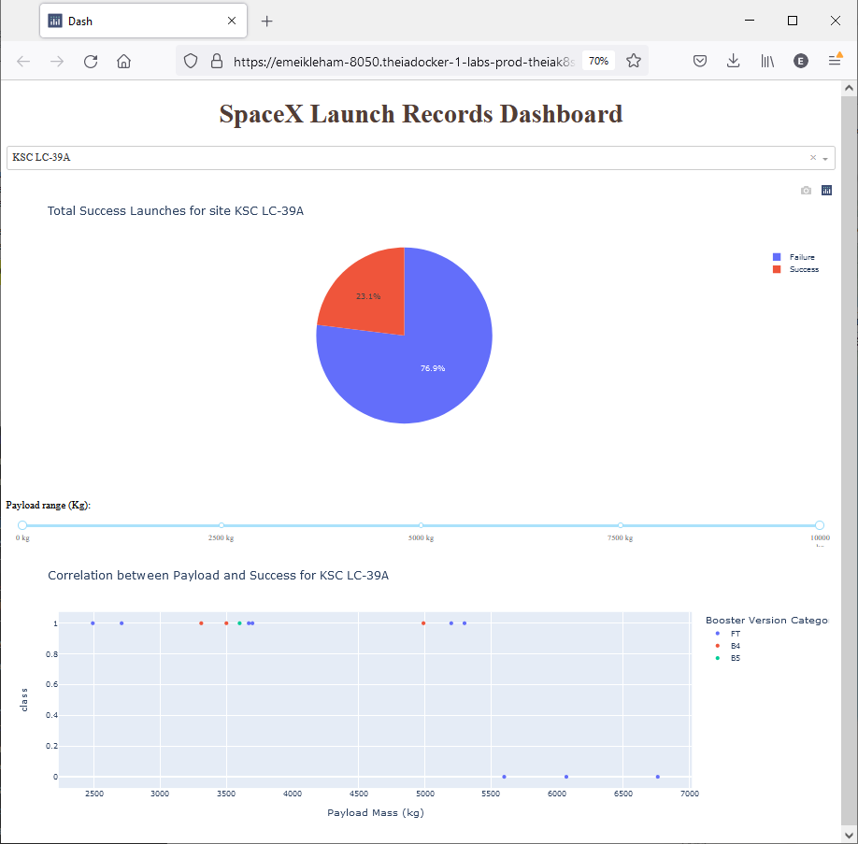
Piechart for Site with Highest Success Rate
Kissimmee was the site with the highest success rate.
76.9% of launches from KSC LC-39A were successful.

Slide 41

Scatter Plot
All sites is chosen in the dropdown menu
Payload (X-axis) vs Outcome (i.e. class, 1=success, Y-axis)
The slider has been chosen for the range 2500kg to 10000 kg

Slide 42


Slide 43
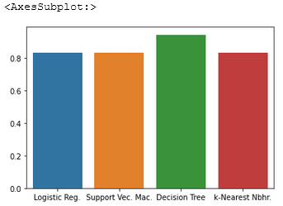
Classification Accuracy
After using GridSearchCV to try various parameters for Logistic Regression, Support Vector Machines, Decision Tree, and k-NN models, and getting scores from the test sets, the best model for classification is the Decision Tree.

Slide 44
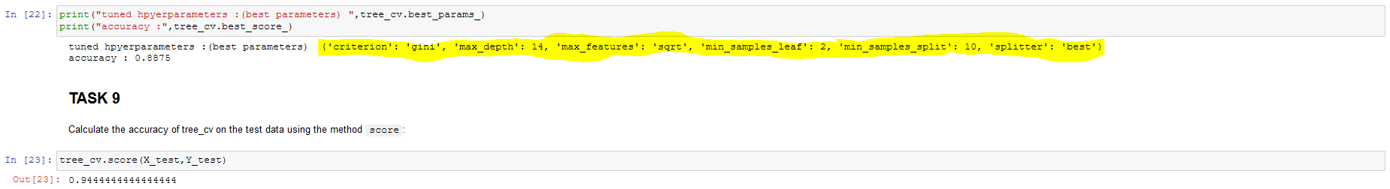
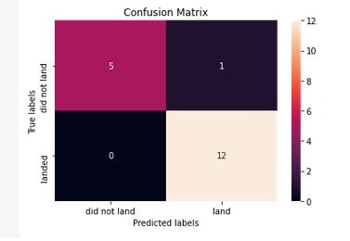
Confusion Matrix
The best model is a Decision Tree using Gini criterion, a max depth of 14, 2 samples per leaf, 10 samples per split, and the “best” splitter.

Slide 45
Conclusions
It seems as though we have found an effective set of descriptive parameters
The model seems well fit when used on the test set
Nevertheless, there are only ~100 datapoints, so there are only ~20 test points
The test score of the best model is over 90%

Slide 46
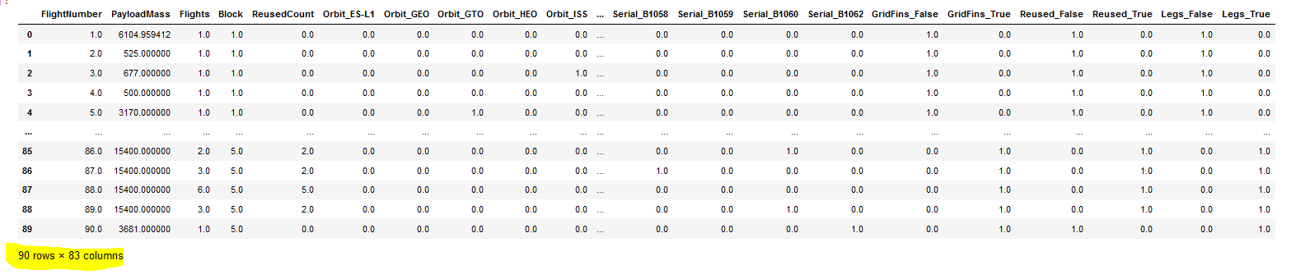
Appendix
The prediction matrix has 83 variables (including one-hot variables)
There are only 90 data points for F9 missions
This table is pre-scaling.

Slide 47


